Slide 1

Jack Auty
Data Analyst Portfolio
Notes:
Hello everybody, my name is Jack Auty, and this is my Data Analyst Portfolio.

Slide 2
Who am I?
Based in Doncaster North DN6, near Barnsley border S72.
Graduated from University of Leeds in 2021
2:1 in Computer Science w/ Artificial Intelligence (MEng)
Recently completed Just IT Data Skills Bootcamp
Gained experience in Azure
Data analysis best practices
Notes:
I’m based in Doncaster and
graduated from Leeds Uni in 2021 with a 2:1 in Computer Science, specializing in AI.
Now, I’m completing a Data Skills bootcamp through Just IT.

Slide 3

Background – Fun Facts
I value my friends and relationships more than anything else
Strong sense of morality which leads me to attentiveness
An unshakeable need to defend and advocate for others
Huge and life-long fan of the hit Manga, One Piece!
Notes:
Personally, I value my loved ones more than anything, and
I have a strong sense of morality which draws forth an unshakeable need to defend and advocate for others..
Evidently, I’m a major One Piece fan!

Slide 4


Background – Technical
Always loved exploring technology
Tinkering with Operating Systems at a young age
Running Minecraft Servers
This curiosity lead me to exploring SQL, Cloud Computing, Data Science and Machine Learning at University
Notes:
Since I was young, I’ve been fascinated by exploring technology—from hosting Minecraft servers to tinkering with operating systems.
This curiosity evolved into a deep interest in data, which naturally led me to explore SQL, cloud computing, data science, and machine learning during my degree.

Slide 5
Background – Work History
You may have noticed the gap between my graduation and completion of this program…
Family commitments
Completed Foundational C# O’Reilly Course
Diagnosed and titrated onto stable medication for ADHD
Few work experiences, primarily academic focus
Looking to secure a role in Data Analysis and these projects demonstrate the necessary skillset
Notes:
As for the career gap…
Basically, I had family commitments, and was diagnosed with ADHD.
However, I'm now eager to secure a role in Data Analysis, and these projects demonstrate the necessary skillset.

Slide 6

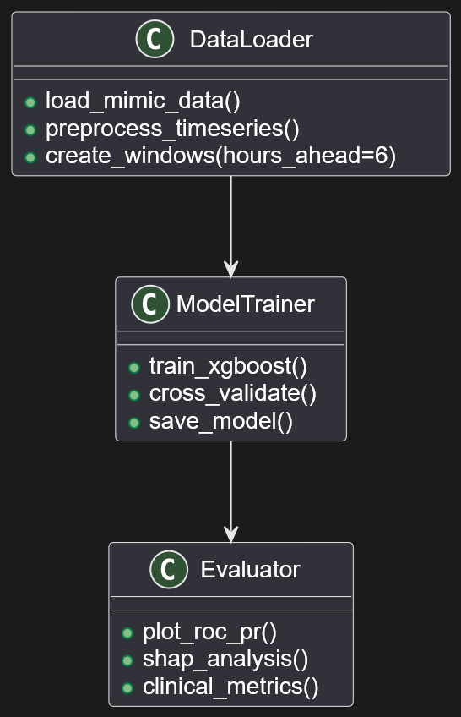
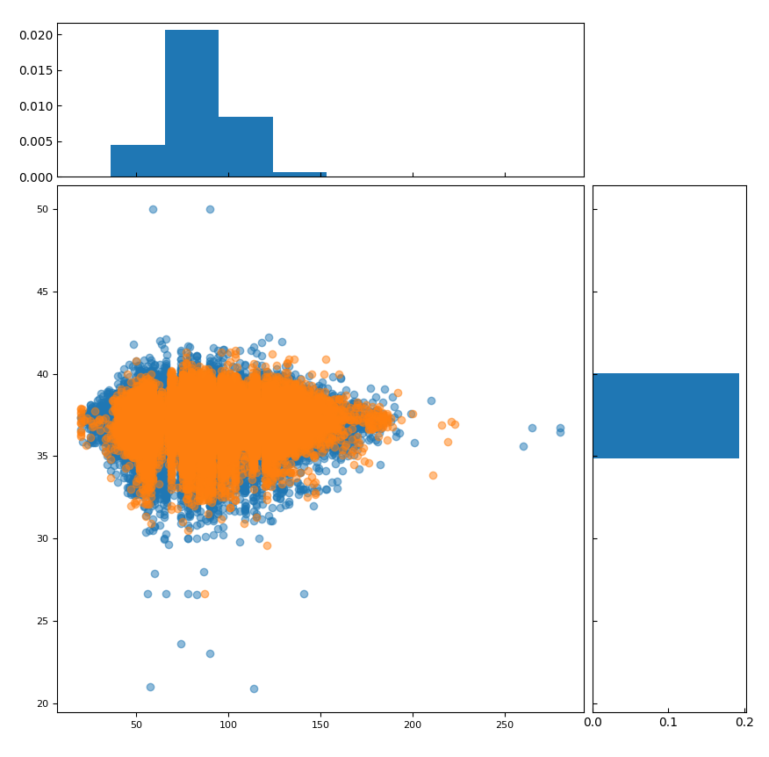
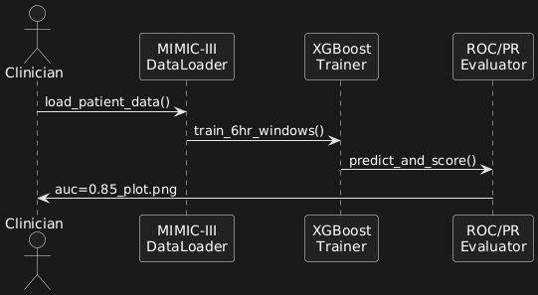
Early Prediction of Sepsis from Clinical Data
github.com/JackEdwardAuty/Bachelors-Project-Early-Prediction-of-Sepsis-from-Clinical-Data
Bachelor’s Project PyTorch implementation
Important to detect sepsis early as vital to improving clinical outcomes.
All patients Temp vs HR
← Old Graph created with matplotlib
Scatterplot with Histograms
Temperature (°C)
Self-Directed (+ Programmatic) Critical Evaluation revealed project issues but bolstered my knowledge
Extracted trends from ICU Blood Test results that allowed earlier prediction than typical methods allow.
Heart Rate (BPM)
Notes:
For my Bachelor’s Thesis, I wanted to implement an ML project to tackle a real-world challenge.
Detecting sepsis as early as possible is vital to improving clinical outcomes.
I used a PyTorch implementation and extracted TRENDS
from ICU blood test data
that allowed earlier prediction than typical methods.

Slide 7
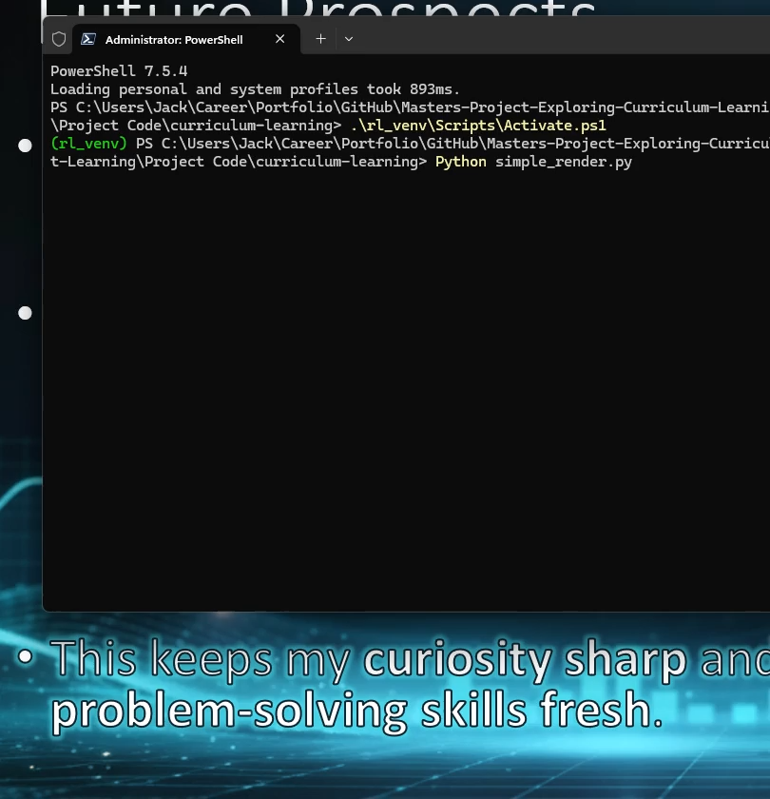
Exploring Curriculum Learning to improve Reinforcement Learning Outcomes
I’m sure we’ve all followed a curriculum before?
…Do AI agents learn better when taught in this way?
First stage of Curriculum:
Single Chaser and Target (live demo)
TensorFlow
implementation
with NumPy for calculations Matplotlib to render visualisations
github.com/JackEdwardAuty/Masters-Project-Exploring-Curriculum-Learning-to-Improve-Reinforcement-Learning
Notes:
I'm sure we've all followed a curriculum before, but
do we think RL agents learn better when taught in this way?
Using a TensorFlow implementation with NumPy and Matplotlib we
first challenged our agent with a simple foundational task – chasing a single-stationary target

Slide 8
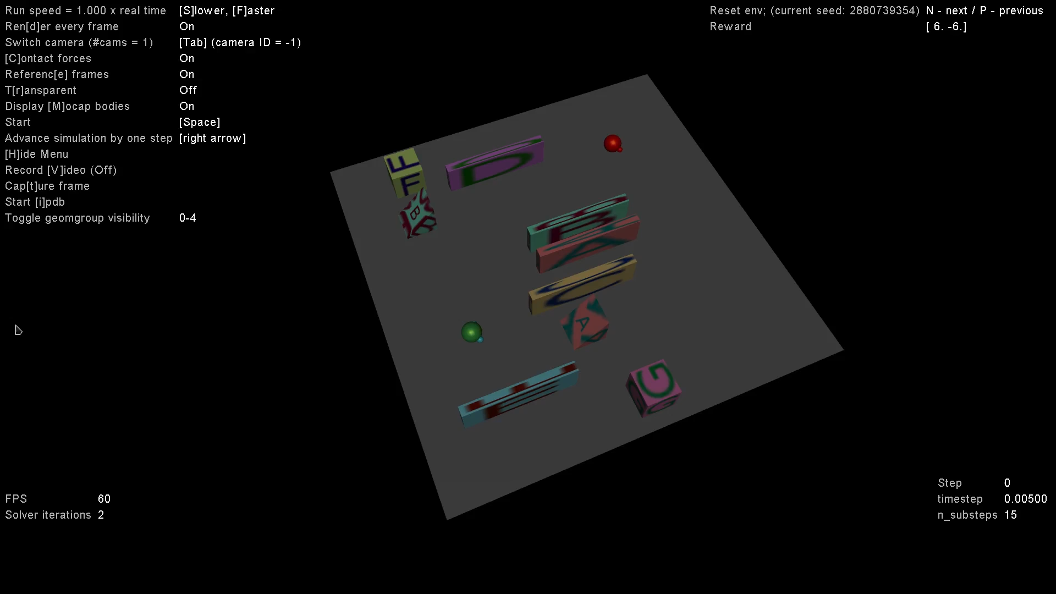
Exploring Curriculum Learning to improve Reinforcement Learning Outcomes
…Do AI agents learn better when taught with a curriculum?
Complexity of RL environment is exponential with added obstacles and agents:
Used to simulate and prepare for relief scenarios such as natural disasters, where the goal is clear but the path towards that goal can vary.
Introduced stationary and agent adjustable obstacles:
Eventually developed into full Hide-and-Seek (video)
github.com/JackEdwardAuty/Masters-Project-Exploring-Curriculum-Learning-to-Improve-Reinforcement-Learning
Notes:
Progressing in our curriculum, we introduced obstacles for the agents to work around.
Eventually, this developed into a full Hide-and-Seek environment.
RL environments are used to simulate and prepare for relief scenarios and natural disasters.
~Their complexity is exponential as obstacles and additional agents are introduced.
An interesting emergent behaviour was that agents learnt to ‘surf’ on obstacles, in order to move and hide at the same time.

Slide 9
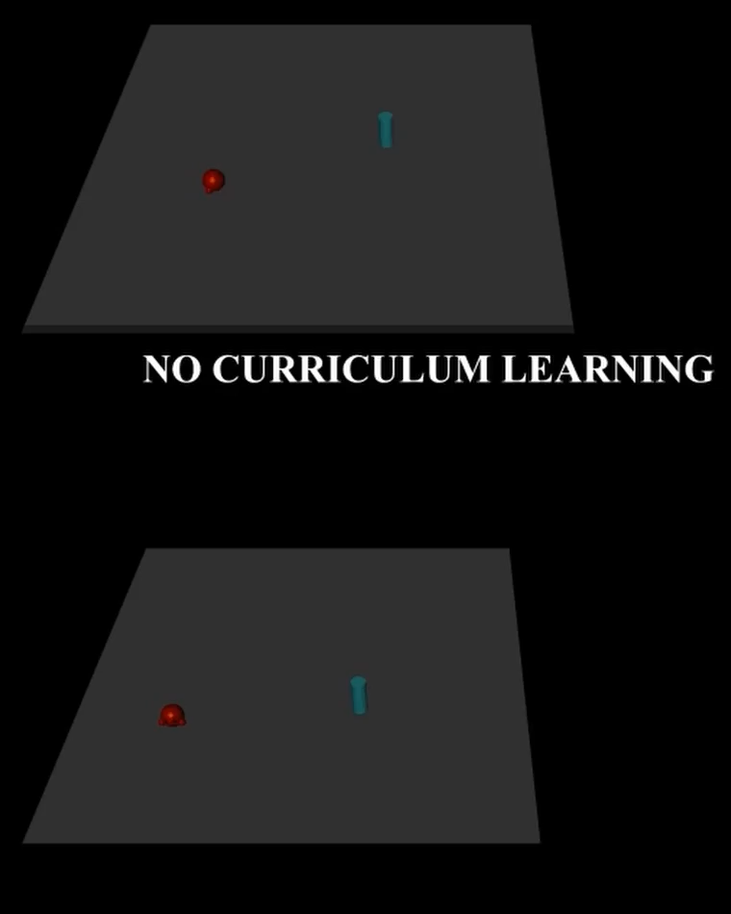
Exploring Curriculum Learning to improve Reinforcement Learning Outcomes
github.com/JackEdwardAuty/ Masters-Project-Exploring-Curriculum-Learning-to- Improve-Reinforcement-Learning
Increasing environment difficulty over time, rather than having agent tackle max complexity at all times.
Side-by-side demonstration of
Standard Reinforcement Learning vs Curriculum Learning
…Do AI agents learn better when taught with a curriculum?
Answer… YES!
Reinforcement Learning agents also learned ‘better’ – more quickly and efficiently – when following a Curriculum.
Notes:
So, the answer to "Do agents learn better when taught with a curriculum?" is
YES!
Reinforcement Learning agents learned more quickly and efficiently when following a curriculum.

Slide 10
Where did this leave me?
Strong Analytical Skills developed
Deep appreciation for the power of data – how it can be used to solve real-world problems
Graduated during Pandemic
Struggled with Confidence, Direction, Imposter Syndrome
Notes:
These experiences gave me strong analytical skills and a deep appreciation for the power of data.
After graduating during the pandemic, I struggled with confidence, direction and imposter syndrome especially before my diagnosis.
That’s why discovering the Data Skills Bootcamp was such an unexpected turning point.

Slide 11

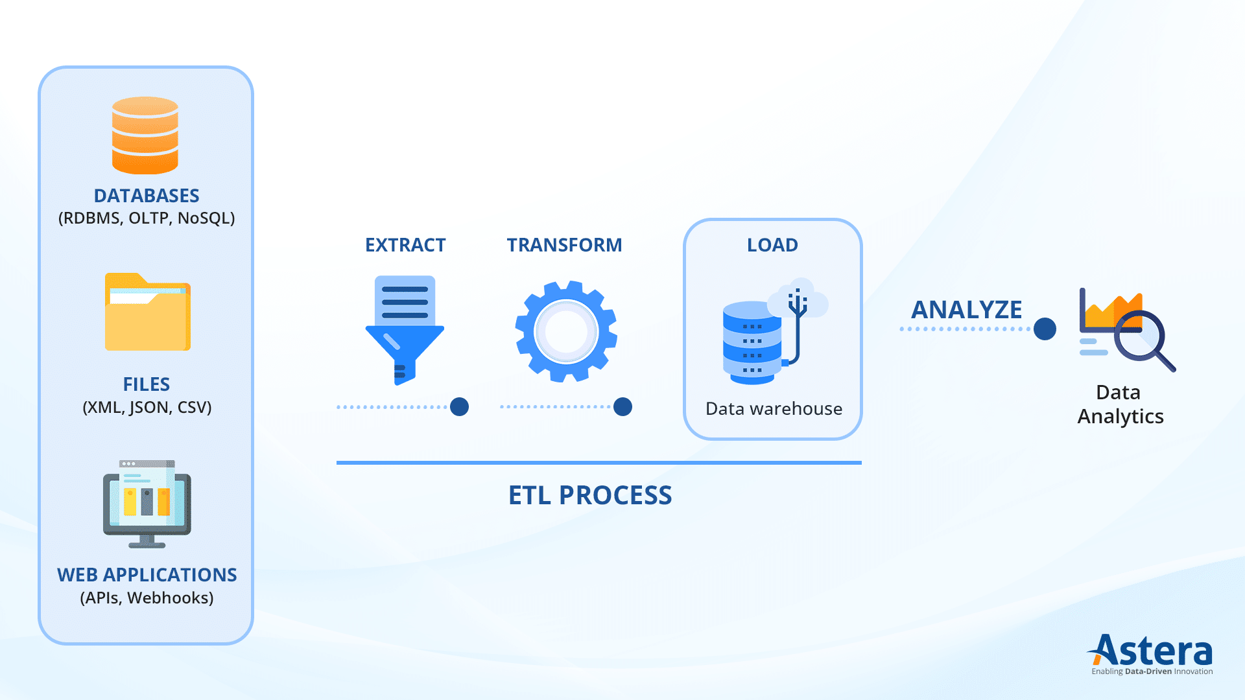
Turning Point – Data Skills Bootcamp
Reignited my drive to enter the industry
Inspiring quality of teaching
Warmth, Resilience and Insight of cohort
Confident in handling Extract, Transform, and Load process along with Data Visualisation and Analysis!
Competency Demonstration:
Markdown Processing Python Personal Project
Notes:
The quality of teaching and the inspiration I drew from my cohort’s resilience, insight, and warmth — has built my confidence and reignited my drive to enter the industry.
I’m now confident in the ETL process and in Data Visualisation and Analysis.
To demonstrate this, I have built a Python project -using DataFrame and Pandas to analyse a dataset of my own.

Slide 12

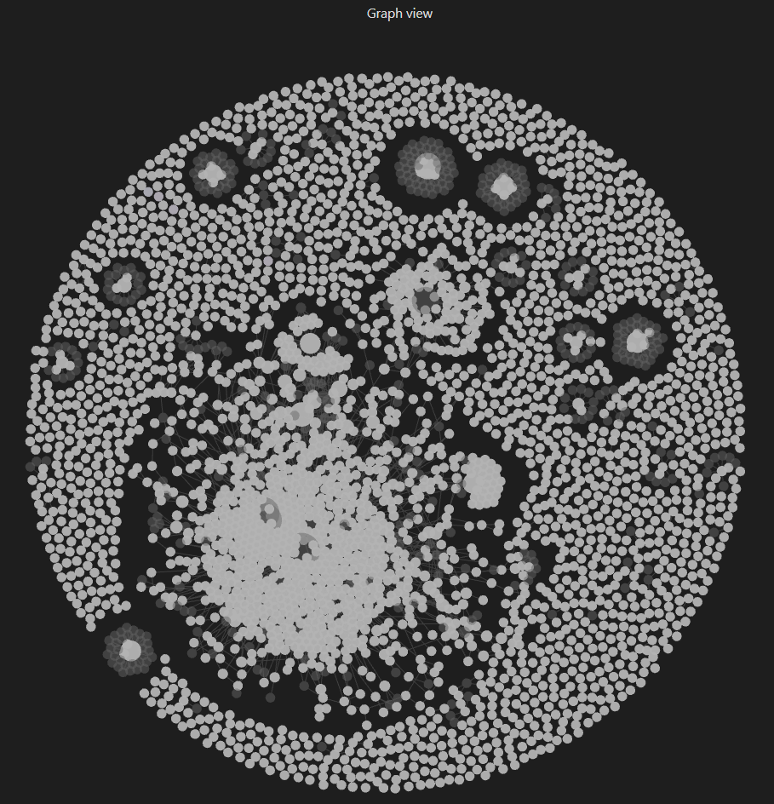

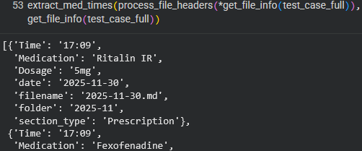
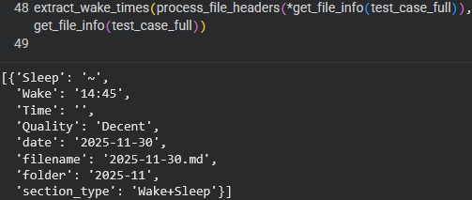
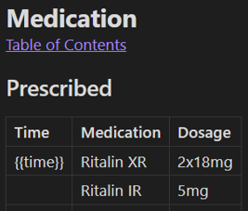
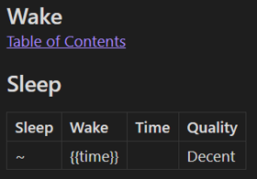
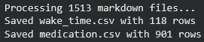
Markdown Processing Personal Project
github.com/JackEdwardAuty/Markdown-Notes-Processing-and-Analysis/
Intro – Data Collection & Tools
Built in Python, utilising DataFrame, Pandas libraries
Markdown: industry standard lightweight markup language used for documenting code bases, processes and readme files.
Obsidian Vault: Custom markdown-based PKM system
templated daily entries for medication details, and wake hours
Custom File-Handling and Data Extraction Pipeline
Custom Regex to handle varying data entry formats across Templates
GRAPH VIEW
Personal-Knowledge-Management
Notes:
My dataset consisted of over 1500 Markdown files tracking my medication details and wake hours through custom Obsidian templates.
I used regex to extract column headers and rows from the fileset, consolidating all 1500 files down to just 2.

Slide 13
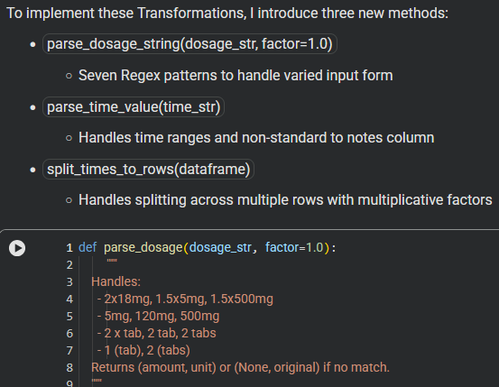
Markdown Processing Personal Project
github.com/JackEdwardAuty/Markdown-Notes-Processing-and-Analysis/
Custom Data Extraction & Normalization Pipeline
Process: Additional bespoke regex patterns for Normalisation parse_dosage_string
Pandas transformations in Python; output standardized format for Tableau.
Transforming the extracted data to ease further analysis
Non-Standard Formats Handled:
Dosage:
2x18mg → 36mg, [Ritalin XR]
1 (tab) → 500mg, 1.5x500mg → 750mg [Paracetamol]
Multiple Times:
15:25, 19:40 → separate rows (same dosage)
Partial Doses:
17:15, 21:35 (half) → separate rows (adjust dosage)
Time Ranges:
09:45-50 → 09:47 (midpoint)
Non-Standard:
logged to notes column for manual review
CSV now files ready for Load stage
Tableau for Visualisation and further Analysis
Notes:
Then my custom transformation and normalization pipeline handled non-standard formats.
I normalized dosages, converted time ranges to midpoints, and logged outliers.
At this point, Transformation was complete, it was all ready to be loaded into Tableau for visualisation and analysis.

Slide 14
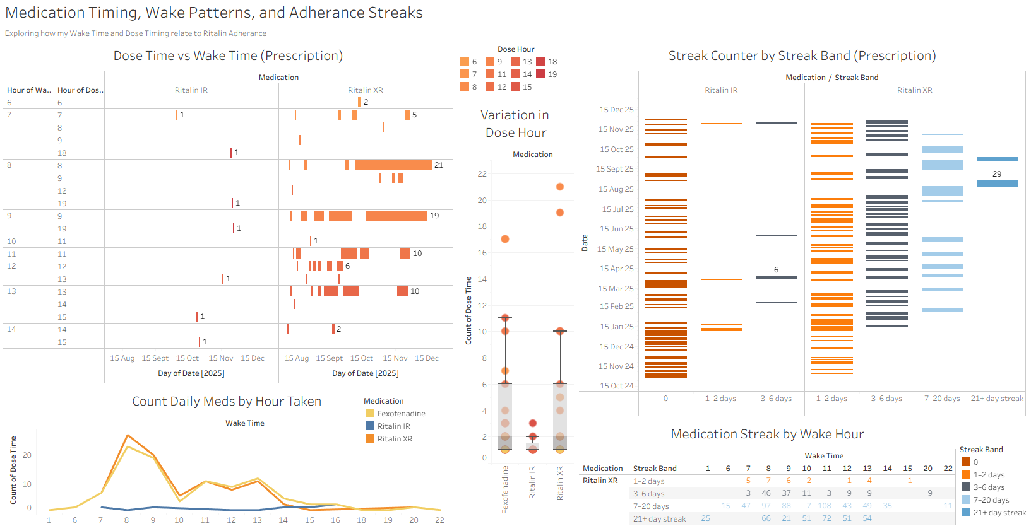

Markdown Processing Tableau Dashboard
github.com/JackEdwardAuty/Markdown-Notes-Processing-and-Analysis/
Notes:
So, here is the final Tableau Dashboard for my Project.
You’ll notice timing patterns on the left, variability in the middle, and long-term streak data on the right.
Using calculated measures I was able to isolate how my wake time impacted my Prescription adherence.

Slide 15

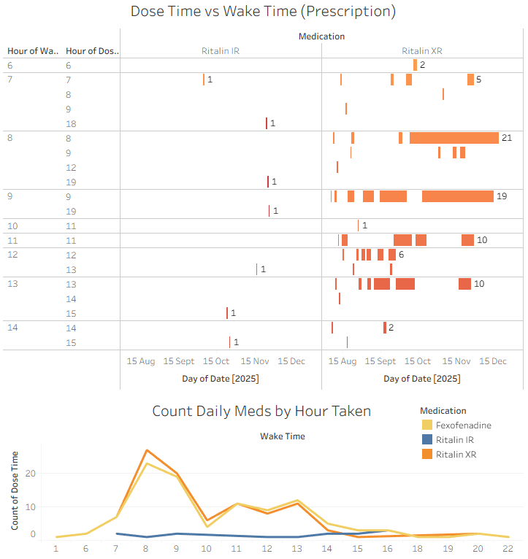
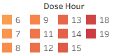
Dashboard Takeaways
Dose Time against Wake Time Using RUNNING_SUM method
Found that most consistently took XR medication at 8 AM and 9 AM
More likely to take (late-day) Ritalin IR the earlier I woke up
Count Daily Meds by Hour Taken
Stayed consistent with Fexofenadine whether woke up too late for Ritalin XR
Confirmation of 8-9 AM consistency
github.com/JackEdwardAuty/Markdown-Notes-Processing-and-Analysis/
Notes:
Most entries for Ritalin XR and Fexofenadine cluster around the morning hours, with distribution more variable as the day progresses.
This tells me that I’m most consistent early, and that I’m less likely to take my XR the later I wake up.

Slide 16
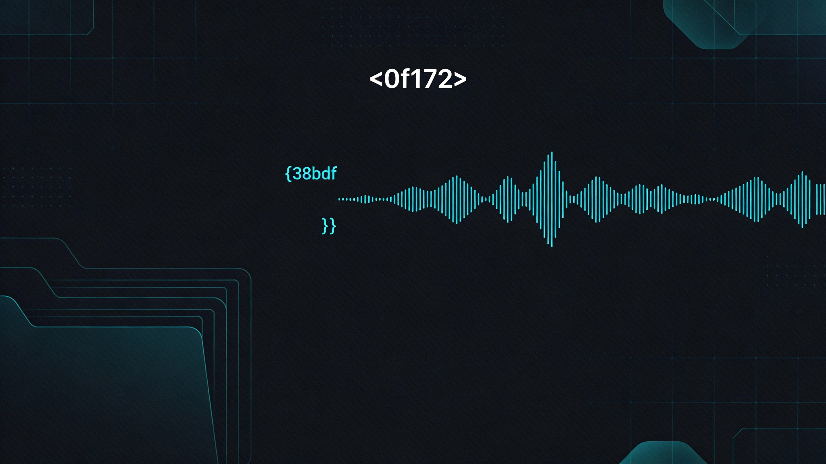
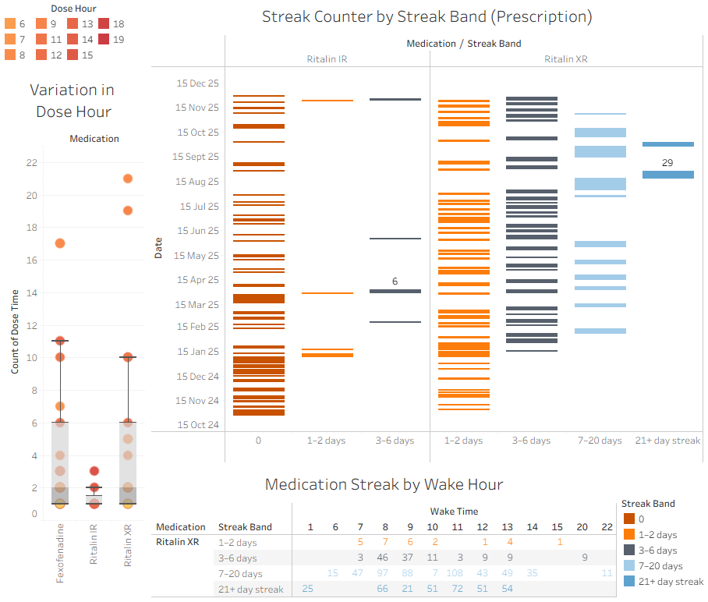
Dashboard Takeaways
Variation in Dose Hour
Box-and-Whisker showing distribution
Streak Counter by Band
Longest XR medication streak was 29 days in a row
Ritalin IR was rarely taken multiple days in a row
Med Streak by Wake Hour
Longest runs (most consistent distribution) occurs when I wake between 8-10am
github.com/JackEdwardAuty/Markdown-Notes-Processing-and-Analysis/
Notes:
The box-and-whisker plot shows how the distribution varied for each medication.
While the Streak graphs show my longest streaks are when I wake between 8 and 10 AM as this shows the most consistent distribution.
(say if 04:20, Cut if get to 04:30)
~They highlight that I rarely take IR on consecutive days; since my longest IR streak was 6, while my longest XR streak was 29 days.~

Slide 17

Future Prospects
Connect with me:
GitHub: @jackedwardauty
Email: jackedwardauty@gmail.com
Eager to begin career in Data Analysis or Business Intelligence
Looking to apply my analytical mindset, love of learning and technical expertise to deliver meaningful insights.
Outside of work I’m a dedicated tinkerer
Open-Source Software
Operating System modification
PC Building (hardware)
Data-driven habit tracking
This keeps my curiosity sharp and problem-solving skills fresh.
Notes:
Outside of work, I'm a dedicated tinkerer—exploring open-source software, Operating Systems and building computers.
This keeps my curiosity sharp and problem-solving skills fresh.
I'm eager to begin my career in data analysis, Im looking to apply my analytical mindset and technical expertise to deliver meaningful insights.
You can connect with me on GitHub, LinkedIn or email me if you have an enquiries.
Thank you for listening, does anyone have any questions?

